Slide 1

TOPIC :CUSTOMER CHURN ANALYIS
CAPSTONE PROJECTS SPRINT3-TABLEAU
NAME:SANJAY SHOME
MENTOR: ASHISH RAJPUT

Slide 2
INDEX
TITLE
SLIDE NO
BUSINESS OBJECTIVE
BUSINESS PROBLEM STATEMENT
DATA PROCESSING USING PYTHON
TABLEAU CODE(ANALYSIS-1)
DASHBOARD-1
CONCLUSION-1
TABLEAU CODE(ANALYSIS-2)
DASHBOARD-2
CONCLUSION
3
4
5
6
7
8
9-10
11
12

Slide 3
BUSINESS OBJECTIVE
“ANALYZE THE DATA CUSTOMER DATA OF A NORTH AMERICAN BANK AND CREDIT CARD OF BANK IS NOT PERFORMING VERY WELL”.

Slide 4
BUSINESS PROBLEM STATEMENT
DISPLAY THE PERCENTAGE OF THE ATTRITED AND THE EXISTING CUSTOMERS FROM THE DATA.
DISPLAY GENDER-WISE PERCENTAGE OF THE ATTRITED AND THE EXISTING CUSTOMERS.
DISPLAY REGION -WISE PERCENTAGE OF THE ATTRITED AND THE EXISTING CUSTOMERS.
DISPLAY THE PERCENTAGE OF THE ATTRITED AND THE EXISTING CUSTOMERS FOR EACH CARD CATEGORY.
DISPLAY THE PERCENTAGE OF THE ATTRITED AND THE EXISTING CUSTOMERS FOR EACH INCOME CATEGORY.
DISPLAY REGION –WISE COUNT OF THE CUSTOMERS.IDENTIFY THE REGION THAT HAS THE MAXIMUM NUMBER OF CUSTOMERS.

Slide 5
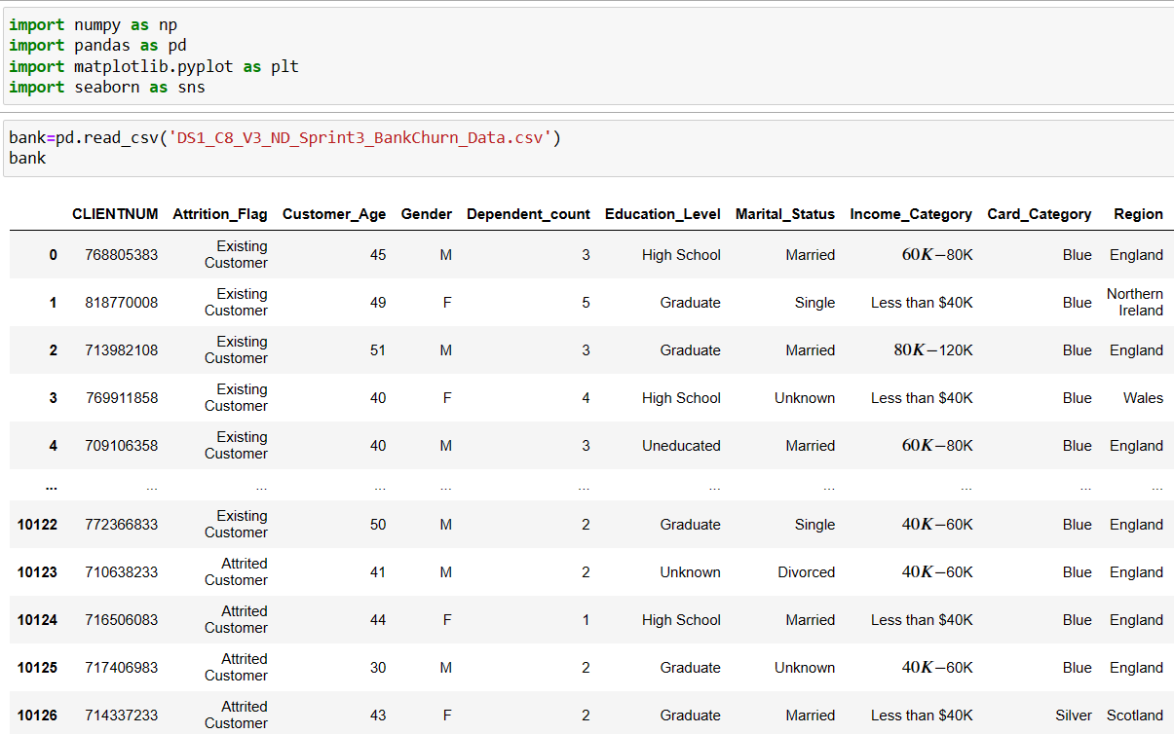
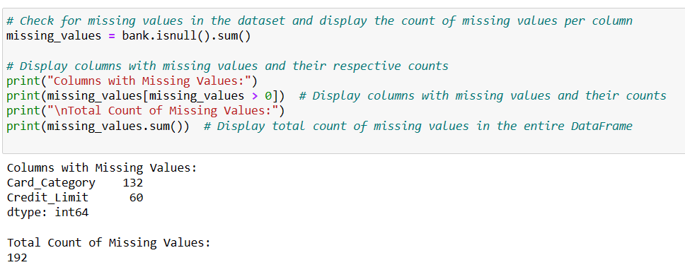
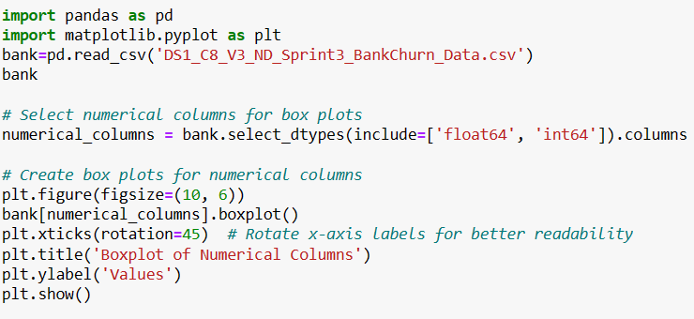
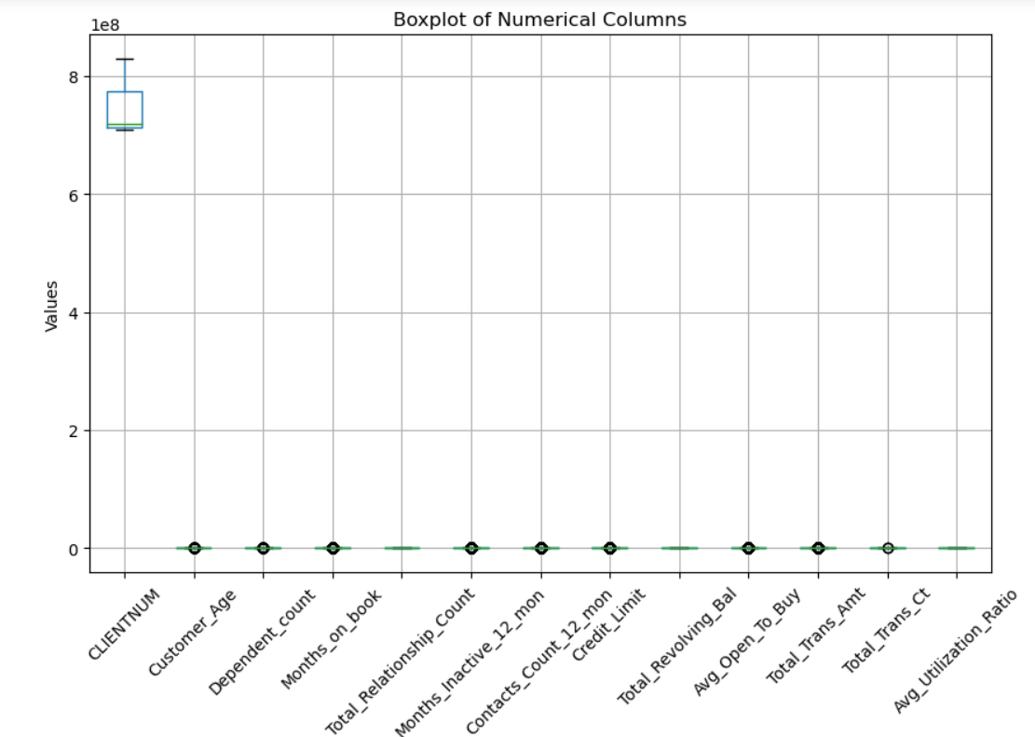
DATA PROCESSING USING PYTHON
SUMMARY STATISTICS OF THE DATA SET
IDENTIFY THE MISSING VALUES AND DISPLAY THE COUNT OF MISSING VALUES
FINDING THE OULTIER AND BOX PLOT

Slide 6
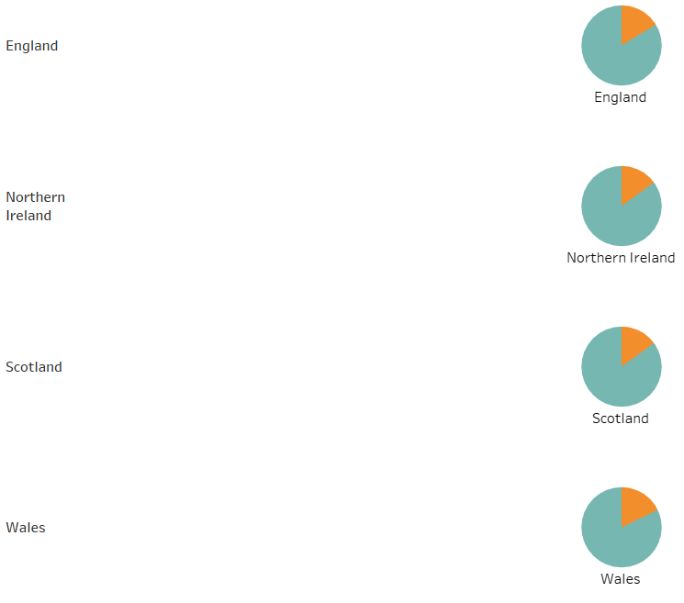
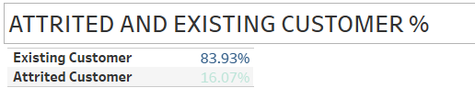
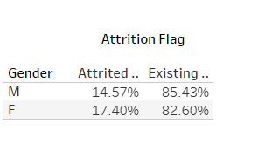
ANALYSIS-1
INTERPRETATIONS
REGION-WISE % ATTRITED AND EXISTING CUSTOMERS
ENGLAND HAS MORE REGION WITH % COUNT 83.68%.
ENGLAND>NORTHERNISLAND>SCOTLAND>WALES
INTERPRETATIONS
ATTRITED &EXISTING CUSTOMERS %
EXISTING CUSTOMES >ATTRITED CUSTOMERS
INTERPRETATIONS
GENDER-WISE % ATTRITED AND EIXTING CUSTOMERS
GENDER
1)MALE-85.43%
2)FEMALE-82.60%

Slide 7
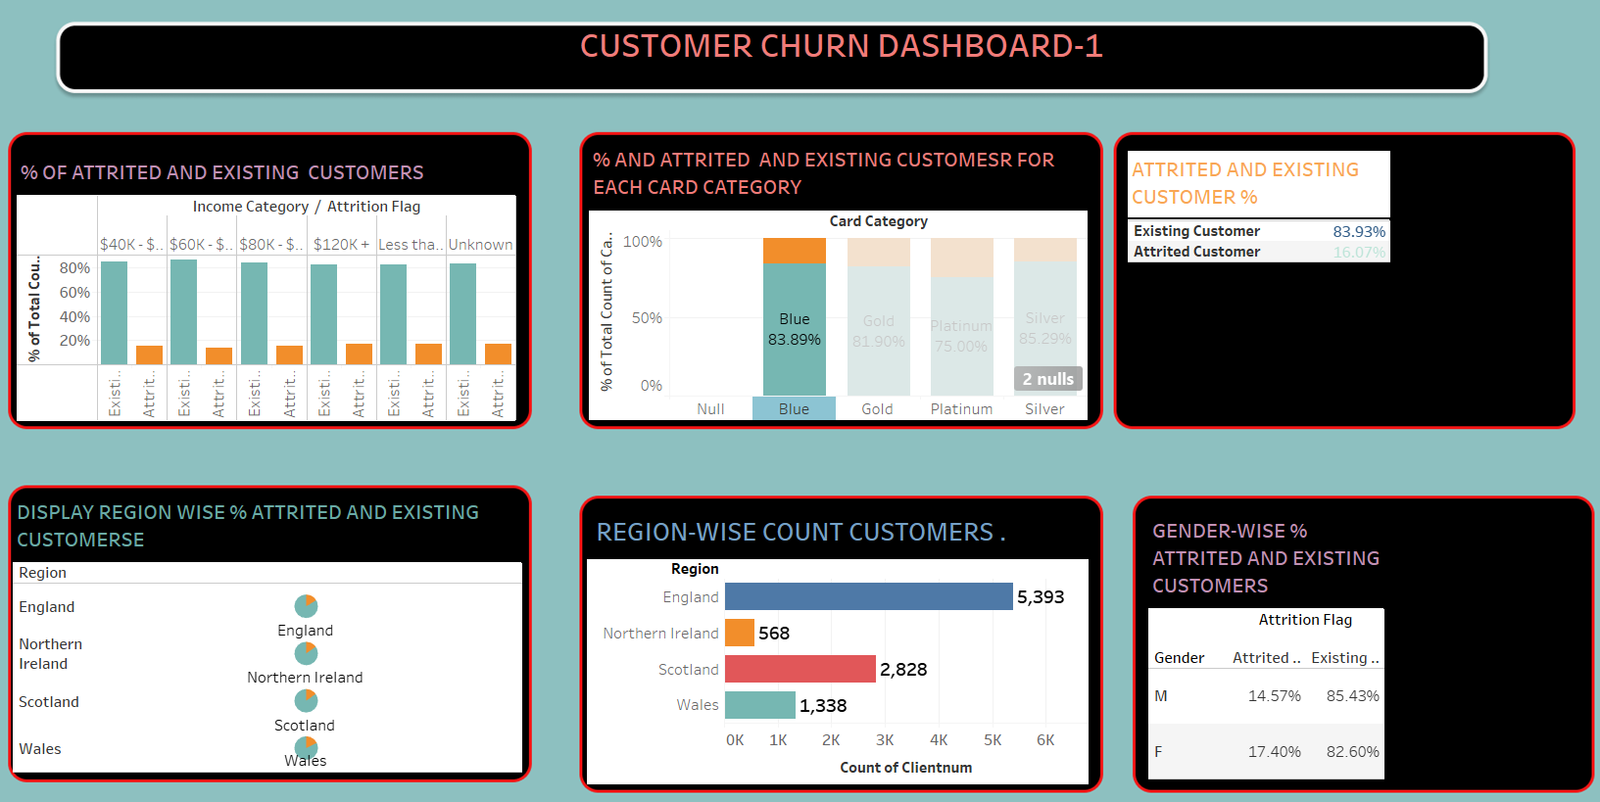
DASHBOARD-1

Slide 8
CONCLUSION-1
REGION WISE % ATTRITED
ENGLAND HAS MORE REGION % COUNT 83.68%
ATTRITED &EXISTING CUSTOMERS
EXISTING CUSTOMERS >ATTRITED CUSTOMERS
GENDER-WISE %
BLUE>GOLD>PLATINUM>SILVER
ATTRITED & CARD CATEGORY
REGION WISE COUNT
MALE>FEMALE
ENGLAND>NORTHERN ISLAND>SCOLTAND>WALES

Slide 9
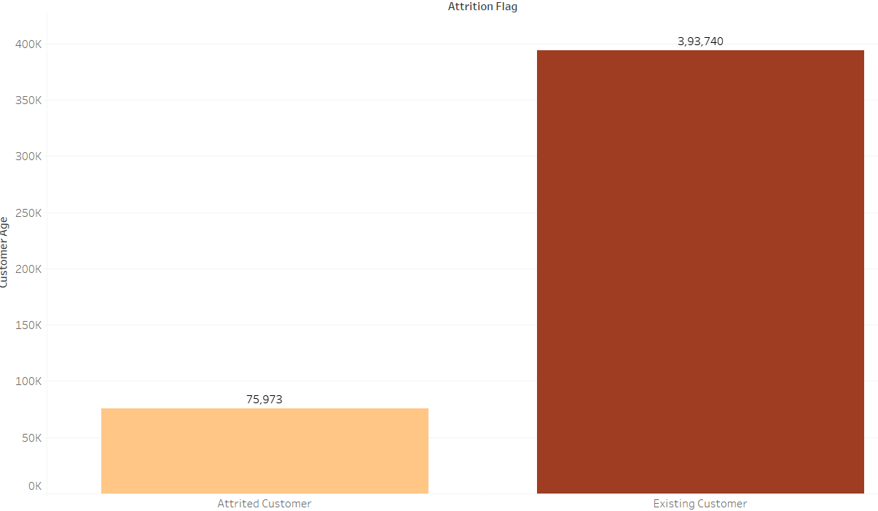
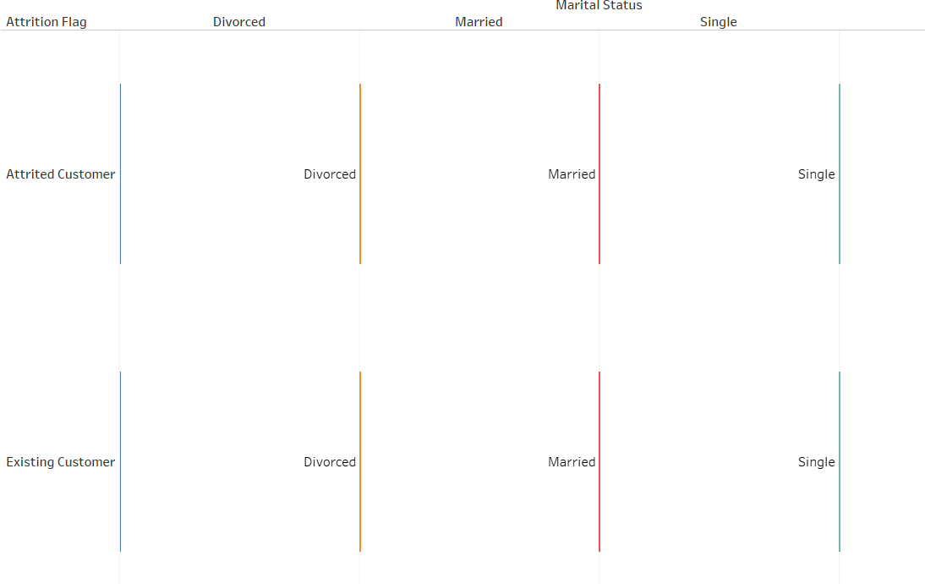
ANALYSIS-2
INTERPRETATIONS
CUSTOMER AGE & ATTRITED FLAG
EXISTING CUSTOMERS>ATTRITED CUSTOMERS
INTERPRETATIONS
MARTIAL STATUS & ATTRITED FLAG
DIVORCED,MARRIAGE,SINGLE

Slide 10
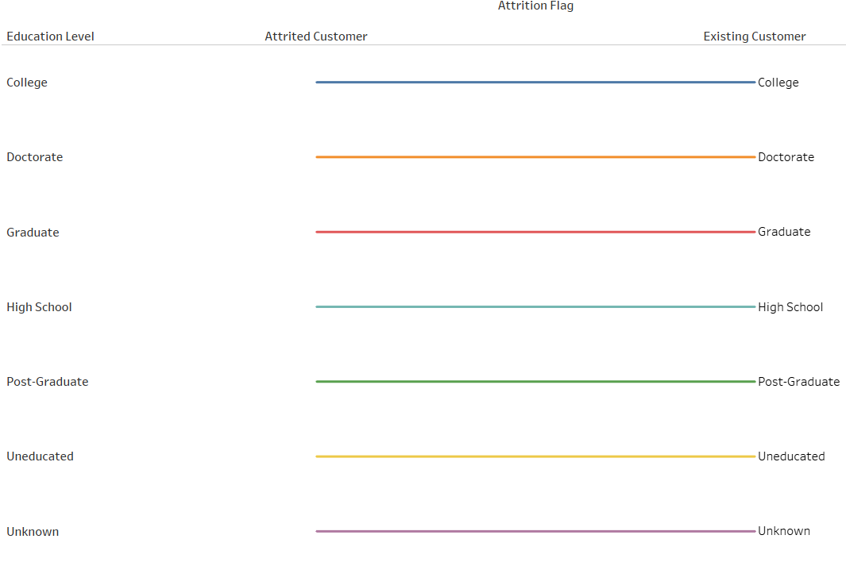
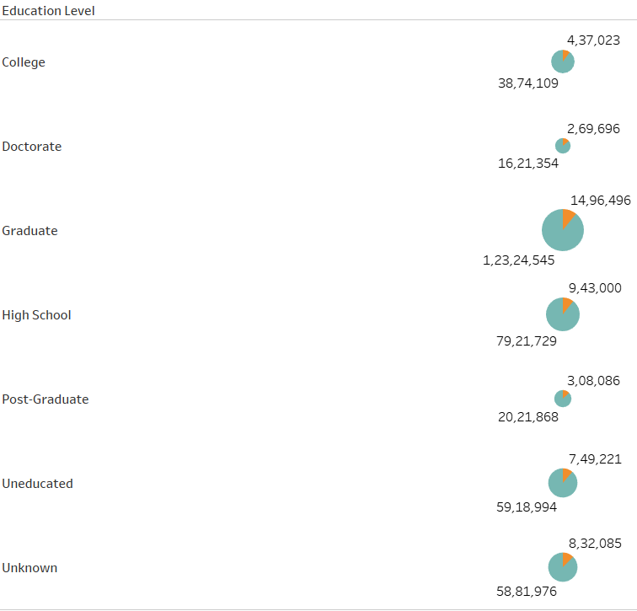
INTERPRETATIONS
EDUCATION LEVEL & ATTRITED FLAG
COLLEGE>DECORATE>HIGH SCHOOL>POST-GRADUATE
INTERPRETATIONS
EDUCATION LEVEL & ATTRITED FLAG
COLLEGE,DECORATE,HIGH SCHOOL,POST-GRADUATE,UNEDUCATED

Slide 11
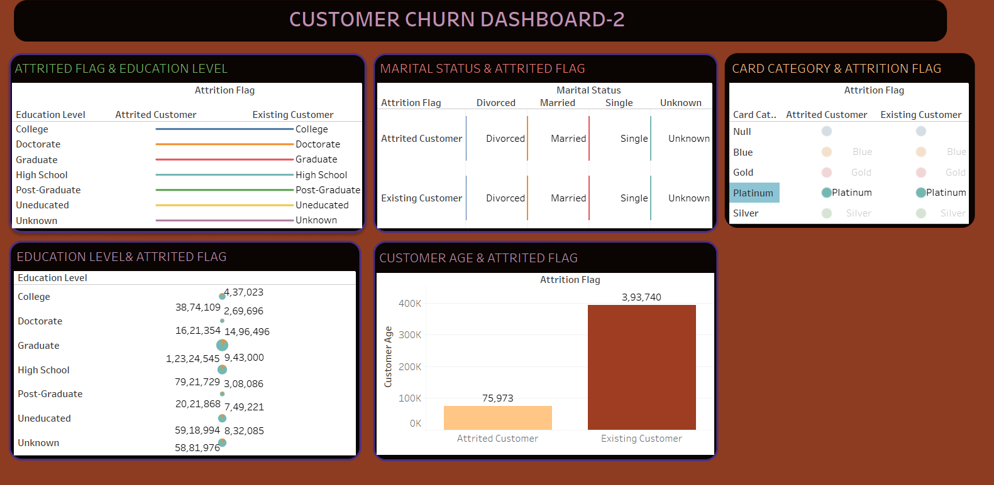
DASHBOARD-2

Slide 12
CONCLUSION-11
ATTRITED FLAG &EDUCATION LEVEL
COLLEGE,DECORATE,GRADUATE,HIGH SCHOOL,POST-GRADUATE
MARTAIL STATUS& ATTRITED FLAG
MARRIAGE,DIVORCED,SINGLE
CUSTOMER AGE &ATTRITED FLAG
EXISTING CUSTOMERS>ATTRITED CUSTOMERS

